Slide 1
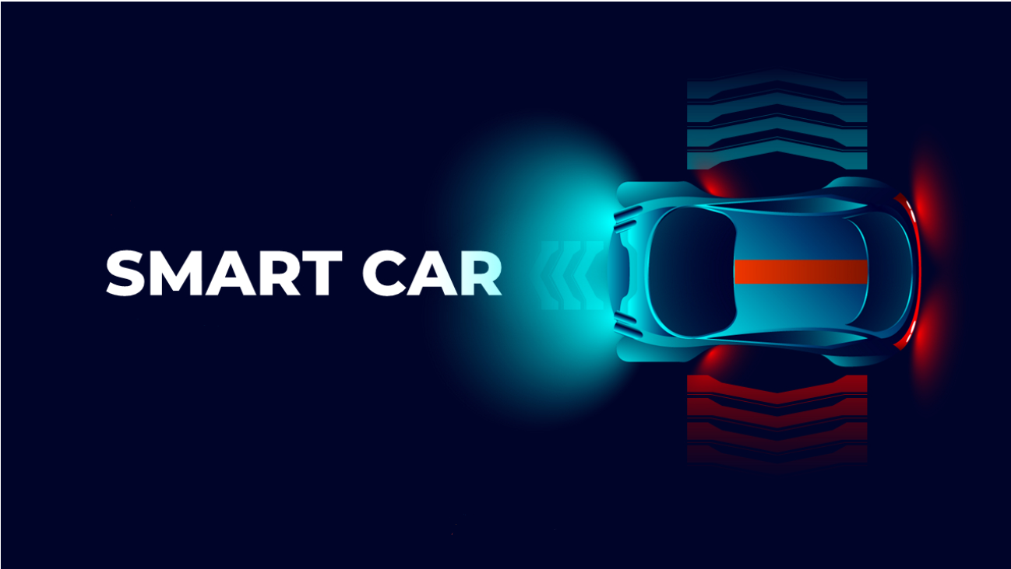
SELF DRIVING CAR

Slide 2

Problem Statement
1.25 million people die in road accidents globally every year, or on an average 3287 deaths per day and 20-50 million people get injured and disabled for life annually, as reported by World Health Organization (WHO). International Road Federation (IRF), Geneva report says that India has the highest number of road deaths and ranking first while accounting for 10% of global road accidents. It is found that 78% of road accidents are due to drivers’ fault or human error in driving and it is interesting to address this human issue with deployment of technology in the form of Driverless Car. This helps in significant savings in time and will reduce the number of road accidents.

Slide 3
Introduction
A self-driving car is a car that can sense its surrounding and navigate without any human input. Self-driving cars are also known as autonomous cars, driver less cars, or robotic cars. Currently, cars are semi-automated and require human control.
Autonomous cars work with the use of different technologies including laser light, GPS, computer vision, radar, etc.
There are many challenges in the field and research is going in full-flow from the best researchers in the industry.

Slide 4

Team Members and Roles
Vinayak Lal (Neural Network and Hardware Implementation)
Udit Tiwari (Image Processing Implementation)
Ashwini Joshi (Image Processing Implementation and Individual Testing of components)
Meenal Srivastava (Overall Testing and Data Collection)

Slide 5
Technologies Used
Software:
Python
Linux OS
MU Code
Raspberry Pi System:
Raspberry Pi 4 Model
Raspberry Pi Camera Module
Motor Control System
DC Geared Motors
L298N Motor Driver

Slide 6
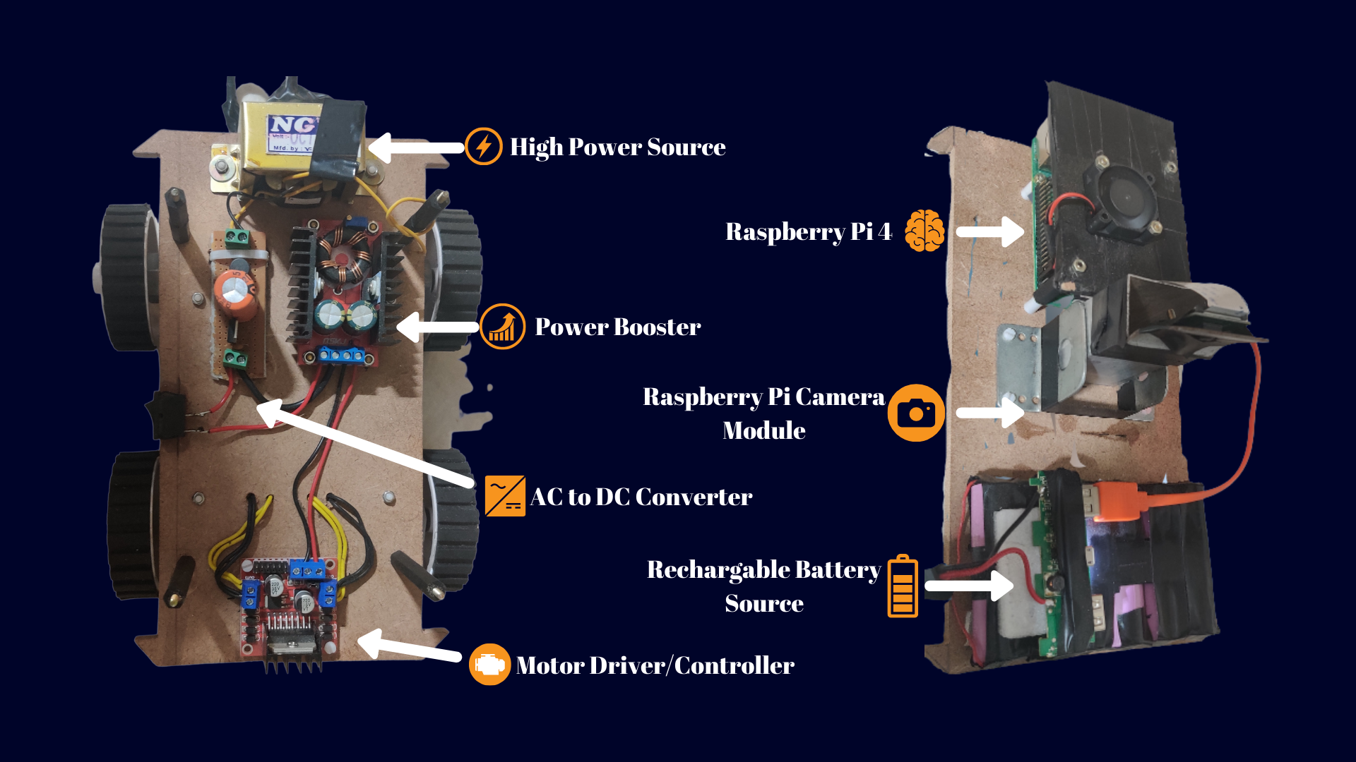
Custom Car Model

Slide 7
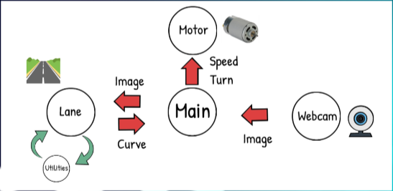
Step 1: Image Processing
The idea is to find the path using color detection or edge detector and then getting the curve using summation of pixels in the y direction i.e., a histogram. Splitting the task into 5 different steps. This includes Thresholding, Warping, Histogram, Averaging, and Displaying.

Slide 8
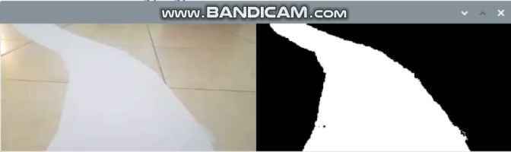
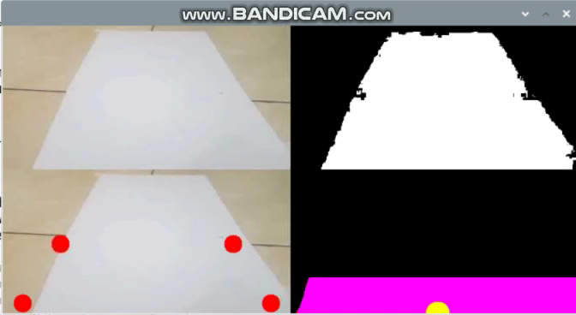
Thresholding
The idea here is to get the path using either Color or Edge Detection. In our case we are using regular A4 White paper as path, therefore we can simply use the color detection to find the path
Warping
Since we want to look at the road as if we were watching from the top. This is known as a bird eye view. To warp the image, we need to define the initial points. These points we can determine manually using trackbars. The idea is to get a rectangle shape when the road is straight.

Slide 9
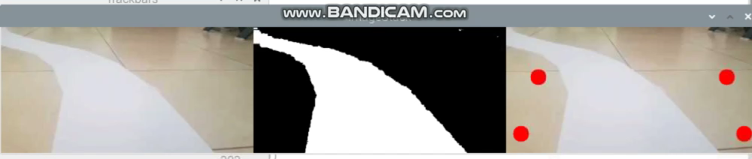
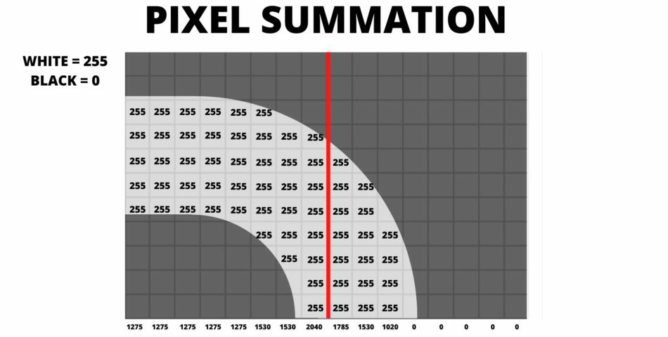
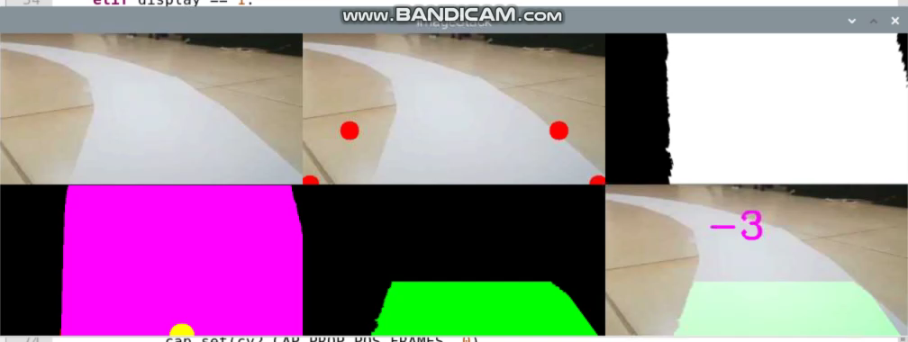
Histogram
To find the curve in the path we will used the concept of summation of pixels. Given that our Warped image is now binary i.e. it has either black or white pixels, we can sum the pixel values in the y direction.
Averaging and Display
Once we have the curve value, we will append it in a list so that we can average this value. Averaging will allow smooth motion and will avoid any dramatic movements. We can add options to display the final result.

Slide 10
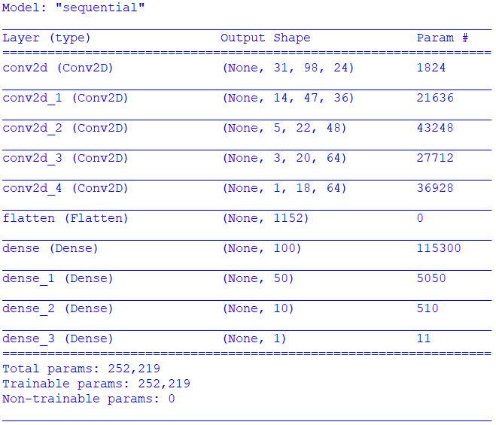
Step 2: Neural Networks
The aim of using Neural Networks is to predict the steering angle using the images of the path and the lane.
Model Used: Convolution Neural Network
Layers: 5 Convo2d Layers with corresponding Pooling Layer with activation function of Exponential Logarithmic Unit (ELU), 4 Dense Layers and 1 Flatten Layer
Input: Image of size (200,66,3)
Output: Steering Angle
Transfer Learning is used in which we used the
pretrained weights of NVidia's self driving car model.

Slide 11
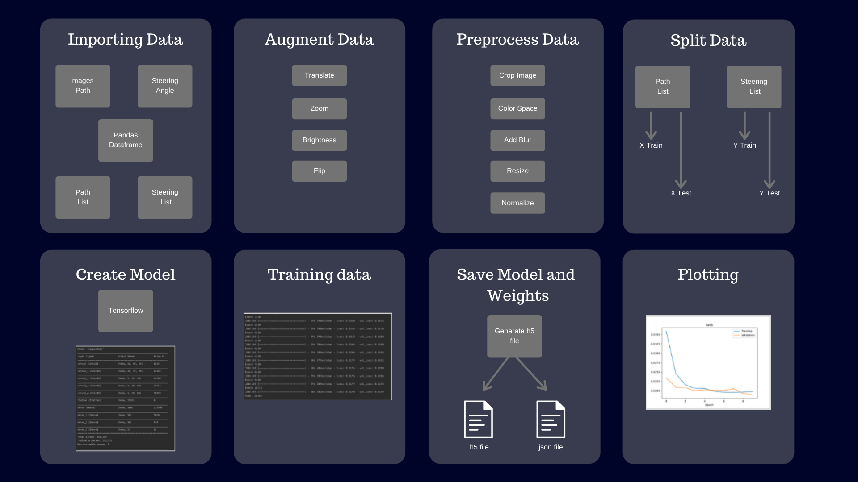

Slide 12
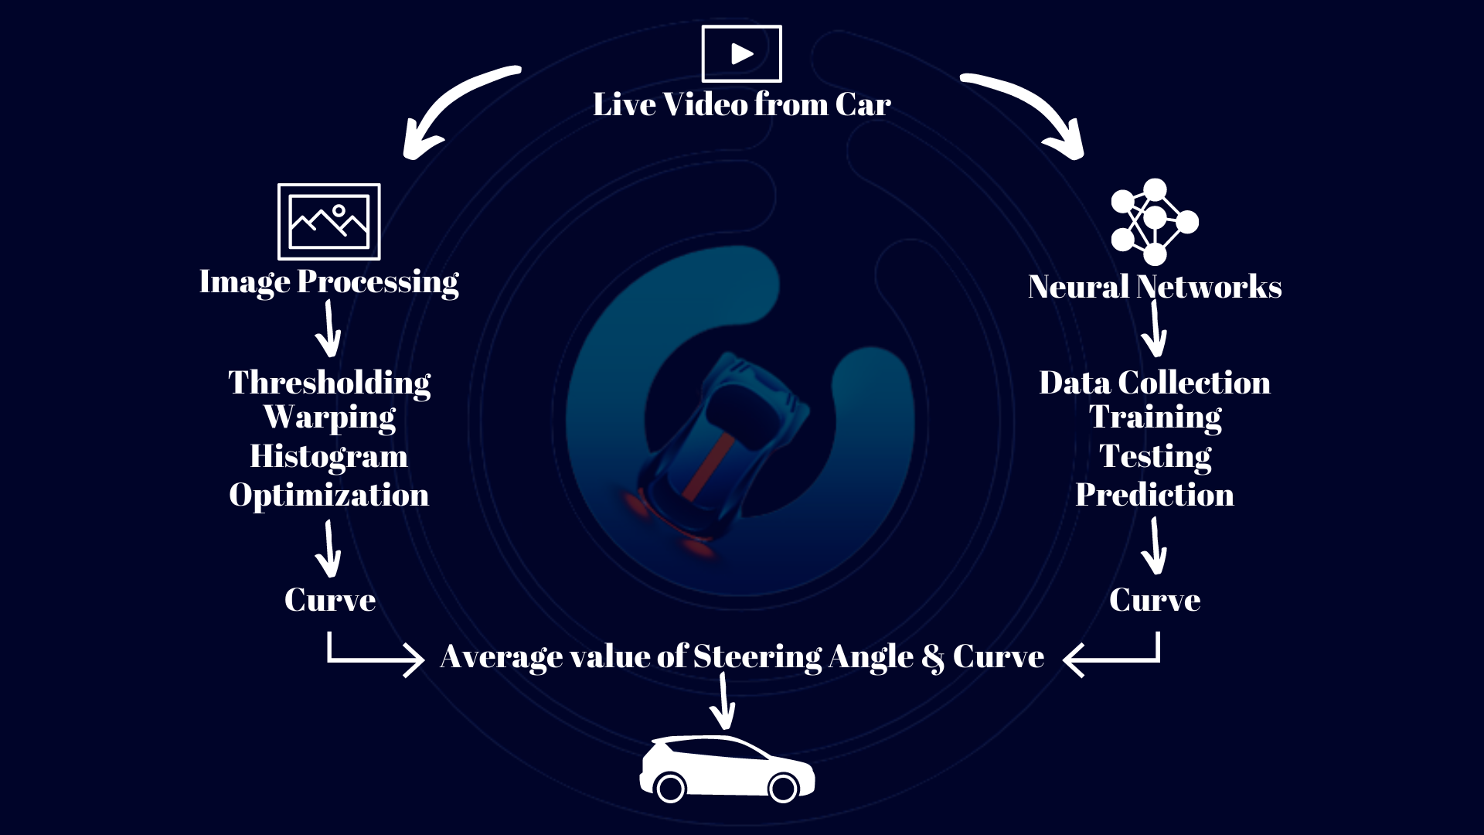
Final Step Averaging

Slide 13

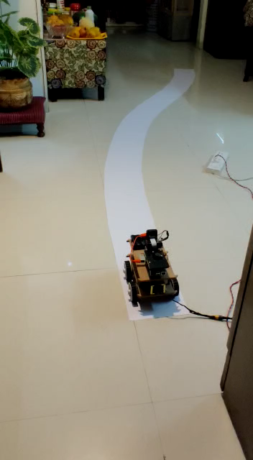
Project Demonstration Video

Slide 14
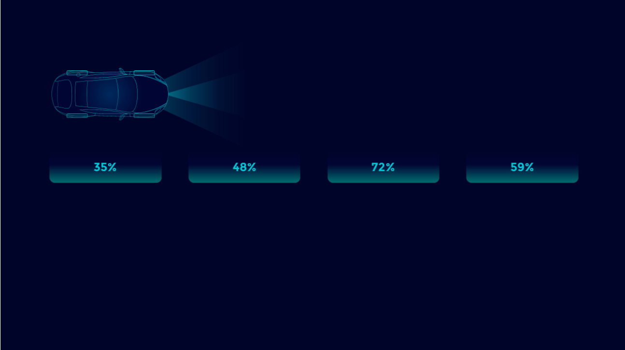
Advantages
Image Processing has to be done only once and works automatically on New Realtime Data.
If we provide a large data set along with embedded sensors the system works perfectly (Compatibility of Sensors and Software)
It is platform independent and with some minor changes can run on any OS and with any language.

Slide 15
Limitations
Small size of Training Data.
Require High Resolution and Quality Camera with Night Vision, as Raspberry Pi Camera will not work properly in Low Light.
Quality of Motors: They require high current and correct voltage to function properly.

Slide 16


